Slide 1
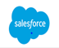
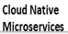


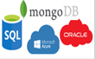



Modernize the Digital Enterprise: Our POV on the Futuristic Tech Platform
Guiding Principles
POTENTIAL TECH
Retire / Replace / Re-write Legacy apps
Customer Lifecycle (B2B)
Adopt Cloud First Strategy
Leverage SaaS or PaaS or Cloud Native Custom applications
Customer Lifecycle (D2C)
Rationalize with ERP’s on IaaS/PaaS
Third Party SaaS Applications
Application Platforms
Product Lifecycle
Rationalize with Azure Data Platform
Open Source & Cloud Databases
Re-host current reporting apps
Data & Analytics
Re-host ERPs
3rd party SaaS applications
Leverage Azure & Open source for DevOps and Event management
Enabling Functions

Slide 2




Modernize the Digital Enterprise: Application Modernization Approach
1
2
3
4
Legacy Apps
Inception
Strategy
Modernization Scenarios
Engg.
App. Portfolio & Architecture Assessment
Architecture Mapping & Design, ROI
Deliverables
Modernization Engineering
6R assessment report
Technical Dependency
Target architecture
Parallel run planning
Roadmap
Headcount estimates
Target Infra decision
1. | Retire
2. | Lift & Shift
3. | Cold Fusion Modernization
4. | Data Platform Modernization
5. | Simplification
6 | Cloud Native (Rewrite)
Security
Top-Down Strategy
3rd Party Ecosystem
Application (Process, Logic, UX)
Data (Migration & Conversion)
Infra
App. Portfolio & Architecture Assessment
Go ahead
Bottom-Up Strategy
Regulatory
Modernization Platform | Tools
Application Modernization Strategy
Application Modernization Engineering

Slide 3
Modernize the Digital Enterprise: Our POV on Cloud Migration/Cloud Native Transformation
Short Term
Mid Term
Long Term
30 Apps
SaaS
Retain / Consolidate
(already cloud native)
3 Apps
Package - Cloud
Retain
OR
Replace / Consolidate
(already on IaaS cloud)
26 Apps
Package
Rehost
OR
Replace
App Hosting Category
(to IaaS cloud)
(PaaS/SaaS)
1 Apps
Custom - Cloud
Retain
OR
(already cloud native)
63 Apps
Custom – On Prem
Rehost
Refactor/Rewrite
OR
Replace / Consolidate
OR
(to IaaS cloud)
(to Cloud Native)
(PaaS/SaaS)
132 Apps
Legacy(ColdFusion)
Retire/Replace
OR
Rewrite

Slide 4



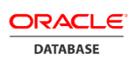


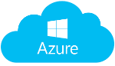


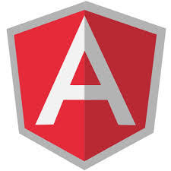
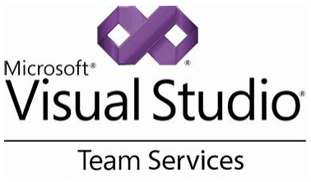
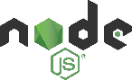
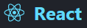
Transform Operating Model: First step is to define Products and Platforms
Business Capabilities Domain
Customer Experience
Sales, Service, Mktg.,Trade, Orders
Manufacturing and Supply Chain
Corporate Functions
Ecommerce
Customer Facing
Portals/Micro Sites
Promotions
Sales
Service
Marketing
Supply Chain Planning
Warehouse Ops
Logistics
General Accounting
Tax & Treasury
Human Capital Mgmt
Internal Sites
Customer Relationship Mgmt. (CRM)
Call Center & Helpdesk
Trade
Order Mgmt
Manufacturing
Plant Maintenance
Quality Mgmt
Claims Management
Procurement Material & Services
Engineering & Technology Domain
Application Platforms
Technology Platforms
Analytics/Reporting Platform
SaaS
ERP
SCM
MDM
PaaS
PaaS
UX
API
Security
Cloud
HCM
CRM
PLM
Reporting & Dashboards
Logging
Error Handling
DevSecOps
ML & AI
PaaS
Custom Applications / Micro Services
Support Platforms
Financial
PLM
Retail
Reference
Technologies
Service Management
DevOps
Database
Languages &
Frameworks
Hosting Platform
GitHub

Slide 5




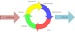
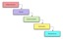
Transform Operating Model: Shift to a Product Operating Model
Customer Experience
Marketing & Sales
R&D
Planning, Manufacturing, SCM
Corp. Functions – HR, Finance, Procurement
Analytics & Insights
Products
Product Management
Product
Backlogs
Product
Backlogs
Product
Backlogs
Product
Backlogs
Product
Backlogs
Product
Backlogs
Plan
Platforms
Application | Micro-services | API | Analytics / Reporting | Security / Authentication | Data
POD & Delivery Teams
Build
Technology Operations
SmartOps | Biz Service Catalog | Hybrid Cloud Ops
Run
Digital Service Desk | Biz Command Center | Security Operations Center | Infrastructure | Employee Experience | Information Security | Reliability Engineering | App Management
Foundational Services
Enterprise Software & Tools | Automation | Service Registry | Cloud | Agile | DevSecOps

Slide 6







We can accelerate your Digital Transformation Journey with our assets and engineering transformation expertise
Discovery / Assessment through Reverse Engg
Productivity tools for agile delivery
Forward
Engineering
VSM
ZDLC
COSMOS
INSIGHTS
ONBOT
COSMOS
MARKET APPS
AUTOREM
AUTOCON
DIGITAL ENGINEERING PLATFORM (FEGO)
Cloud-native microservices
Monoliths
Smart APM
We are the ‘Partner of Choice for Engineering Transformation’ for major industry leaders across business segments
Backstage DC 2.0 Implementation
End-to-end Integration Platform
Sales Modernization
Unified BUILD & RUN model
DevOps Automation for COTS
End-to-end DevOps Impl.
App Stability Assessments
Agile Coaching-as-a-service

